Slide 1
Actuarial Case Example

Slide 2
EXL’s expertise in Product Development & Management makes us trustworthy partner
Product Planning & Designing
Underwriting
Product Pricing
IT Systems
Product Launch
Product Development
Rule Engine
Pricing Model Maintenance
System Changes
Market Identification
Enlist Product Features
Case Management
Factor Calculation
Process Improvement
Layout Strategic Plan
Build MVP
Integration with Eco system
Rate Monitoring
Development Support
Go to Market Launch Plan
Testing
Analytics & Documentation
Model Prep/Runs
Testing
Documentation
EXL leverages next-generation technologies effectively to drive further efficiency and enhance quality across different activities of PDLC

Slide 3
Development of Group Protection Rater model over Dataiku
Objective
To develop a robust integrated Group rater model for short- and long-term disability products on Dataiku platform to enable Group sales and strategy team.
Import precise census data and plan information for all STD / LTD products from various systems
Delinquencies occurs when data is unavailable or if any data related query is unresolved
Consolidate / import external data using SQL/Python queries
Clean, stack and standardize consolidated data for ingestion using SQL/Python
Modeled STD and LTD rater calculator on Dataiku for BD team using SQL queries, MS Access
Dataiku
SQL
MS-Excel / VBA
MS-Access
Python Language
R Language
Key Challenges identified
Solutions Delivered
Software/Tools used
Process Followed
Consolidate Data
Process data using SQL/Python
Quotation Rating Test
Communication
Validate all data transactions
Identify mislabel contracts
Stack input data from various product systems (like UWWB, QE and QUEST)
Clean finalized data for ingestion
Derive required factors using SQL and MS Access
Calculating required fields via derived factors and formulae
Apply ratings to data using pre-defined algorithms
Validate all output by applying reasonable checks
Scenario test with Underwriting Workbench Production
Export and update the output format
Final rater model delivered with client BD / Strategy team
Provide appropriate responses to the stakeholder queries
Value Delivered
Integrated Group Pricing/ Quotation system
Sales Enablement
Reduced Turnaround Time
Enhance Actuarial bandwidth
STD : Short Term Disability LTD : Long Term Disability BD : Business Development

Slide 4
Product Development Support
Product setup on policy administration system (FA & WL)
Objective
Transition to a new policy admin system by a US Life insurer with aim of addressing all the identified errors
Key Challenges identified
Enable cross functional knowledge transfer through collaboration.
Robust policy life cycle documentation
Identification of all possible policy transactions.
Enablement of IT team through BRD and test cases.
Correct system setup delivered together with product setup documentation.
Existing system suffered from inaccurate Product configuration leading to incorrect payment of Annuity benefits, specifically in case of indexation and joint life annuity payments
The system also failed to accurately capture the Rider complexity.
Lack of Product Setup Documentation.
Policy values incorrectly calculated in the system.
Solutions Delivered
Process Followed
Business Requirement Document and Test cases
User Acceptance Testing (UAT)
Sign off for Production
Actuarial Analyst liaison with Pricing / Product team to create business requirement document enabling IT team to setup admin system
Document entails policy life cycle scenarios and respective test cases
Test cases and test scenarios are validated against expected output by a team of junior actuaries with help of excel based calculators
Feedback to IT is provided for corrections (if any)
Final UAT report is reviewed by an experienced Actuary and signoff is provided for system to Go Live
Value Delivered
Knowledge Repository
Control Environment
Auditable Process / Setup

Slide 5
Actuarial model transition from ALFA to AXIS
Objective
Develop and transition from ALFA to Axis for FA , FIA, IVA etc products and create excel validator model for audit and review
Complex product features to be modeled
Modeling of different option values originating via different guarantees
Multiple funds available within one product
Target reduction in runtime
Prepared detailed BRD for Axis model and validation tool
Model transformation from MGALFA to Axis
Developed robust excel validator model for auditing and reviewing AXIS model results
Detailed documentation of model development for future reference and guidance
Moody’s AXIS
MGALFA
MS-Excel
MS-Doc
Key Challenges identified
Solutions Delivered
Software/Tools used
Process Followed
Process Walkthrough
Validate Model Spec
Document Modelling Gaps
Validate Excel Output
Communication
Regular connects with client side for process walkthroughs and queries.
Weekly meetings with client for progress update
As the project involved modelling multiple product with varied features, exhaustive validation was performed to ensure each feature is captured in both Axis & excel validation model.
BRD was updated with audit findings and identified gaps along with resolutions, full book impact analysis of transformation was also documented.
Excel Validation model was tested for individual policies capturing all products/product features.
Variations were corrected & documented in BRD.
Stakeholder communication was ensured to be timely & efficient. Sign Offs on understanding, solutions & findings were taken.
Value Delivered
Knowledge Repository
Domain Knowledge
Auditable Process Setup
FA : Fixed Annuity
IVA : Indexed Variable Annuity

Slide 6

Reserving
Case Example 1: Annuities valuation supports annuities products valuation and its sub processes
Planning & Assumption
Data Preparation
‘GGY AXIS’ Run
‘Result Reconciliation’
Valuation Review
Report & Insights
Output
Benefits
Assumptions review between Valuation Actuary & Modelling Actuary
Some of the focus area are changes in swap rates, treasury rates, NPR spread and volatility
Cross team collaboration b/w Modeling, Valuation and Adim teams
Reconciliation (comparison between different data sources)
Quality checks – anomalies, demographic and financial changes
Reporting of any missing/additional data
Dataiku runs to prepare the inforce
Valuation runs performed for different products on different assumptions, sensitivities and shocks.
Replicate results of old valuation in the current set-up
Update assumptions and modification
Reconciliation of results from different reports
Different teams reconcile data agreed up to certain limit
Check impact of assumption changes
Tableau to create reports as per client requirements.
Review results sample lives
and global checks
Analyze the movement of valuation results when compared to previous valuations
Check reasonableness of Valuation results
Out of Model Adjustment
Generate valuation report on required bases of monthly / quarterly / annually
Peer review report content for reasonable-ness, accuracy and completeness
Regulatory reporting - VM21, CARVM, FAS107, FAS157, MRB, Cigna reporting.
Check the trend as it should match the assumption changes
Benefit Statements
Benefit Information of Inforce and New Business
Decision Matrix
Decision to make any changes in the future valuation
Control points for quality check
Increased efficiency by 20%
Reduced TAT by ~ 25%
Multiple GGY Axis runs offshored
50% reduction in manual reports preparation
Streamlining of processes
Actuary
Business Analyst/Data Steward

Slide 7





Continuous Improvement
Case Example 2 - Annuities - FIA Valuation Transformation
Built “One-Click” automated data extraction and processing tool in Python, while maintaining a user-friendly Excel based interface for output review
Background
Solution
Streamline the end-to-end FIA Valuation process by eliminating manual interventions in input data extraction, processing and validation
Eliminating multiple data sources interaction, including Oracle BI, SQL, flat files (csv, excel) and reducing process run-time, currently 24 hours
Input Data Extraction
Data Processing
Output Generation
Creating Staging Zone, consolidating input files from varying sources
Eliminating user’s interaction with Oracle BI, SQL for input data extraction, via automated data fetch
Building utility, incorporating re-runs (in case of model changes)
Data reconciliation and processing is triggered post consolidation of input files in the Staging Zone
Reporting files are processed in parallel, eliminating sequential processing (current state)
Exporting results to Excel (Business Unit defined template), presenting output overview
Generating Audit Log, provides ‘one-stop’ review of all varying checks built across output files, reducing results review time
Challenges Faced
Error-prone process due to high degree of output files interdependencies
Significant time consumption for gathering inputs from multiple sources to prepare inputs for processing
Data reconciliation across different input sources was a manual and time-consuming process
Incorporating non-standardized checks across different files for data validation
Development Time
Business Impact
1 Month
Development
1 Week
Testing
100% Automated Data Extraction
80% Reduction in Processing Time
Elimination of multiple data sources
Automated Data Reconciliation and Validation

Slide 8
Modeling
Case Example 3: ALM projections and regulatory actuarial modeling of Retirement Product in MG Alfa
Key Challenges
Understanding the impact of regulatory changes on the company’s assets and liabilities.
Understanding the impact of regulatory changes on rebalancing of Asset portfolios.
Decide what investment strategy should the insurance company adopt to ensure it meets regulatory changes
Our Solutions
Modelling Asset and Liability of a Life Insurance company as per regulatory changes.
Demonstrating the impact of regulatory changes on Asset and Liability cashflows.
Suggesting possible asset portfolio mix that can help the insurance company meet its regulatory requirement.
ALM Modeling Process
Data Processing
1.0 Plan & Requirement Gathering
2.0 Model Changes
3.0 Test Runs
4.0 Projections
5.0 Results
Data collection
Policy Admin System.
Asset Data/Market Data
Asset Management Charges/other expenses
1.1 Regulatory Guidance
Understanding regulatory changes (such as change in Tax rate on Investment income , change in commission rate on new business. etc.)
2.1 Identifying Model Changes
Identifying variables that affect the asset & liability
Select variables require coding changes. (e.g. Tax rate, investment return, commissions etc.)
3.1 Singe policy run
Running a single Policy to validate coding changes
4.1 Prepare cash flow projections for single Policy
Run single policy
Validate impact on Assets and liabilities
Validate projections of asset & liabilities such as Claim amounts, market value of assets etc.
5.1 Full Model Run
Running the inforce file containing all the policies of select product group.
Data Validation
Identify data errors
Missing/unexpected values
3.2 Error identification
Identifying model run errors such as invalid syntax, unknown identifiers.
5.2 Results analysis
Comparing future claim amounts with future market values of different assets classes such as bonds, equities.
1.2 Plan and Prioritize changes
Plan what changes need to be made and the order they need to be incorporated in model
Investment Performance Analysis
Comparing the company’s asset performance with benchmark assets and identifying main reason for difference.
2.2 Code Model Changes
Change Tax rate on investment
Change commission on NB.
Prepare In-force file
Converting validated data into the required inforce files format using SQL
3.3 Fix errors & rerun
Correcting model errors and rerun. Repeat process till no errors.
5.3 Asset classes Identification
Identify assets that can match future liability values
Suggest possible asset portfolio mix.
Identifying assets classes above benchmark level.

Slide 9







Process Improvement
Case Example 4 - Transforming US insurer’s longevity risk models for Retirement products using python
Retirement Team is working to migrate US insurers excel based longevity models to web application without compromising the calculation transparency that excel offers.
Background
Reconciliation flow
Technology
In the existing model workflow, a user must interact with the excel and different data sources to generate a retirement model.
LRM Model
Viewer
Pickled run
stored in Cassandra
database
View prior run results
Key Objectives
Liability Cash Flows
Retirement modelling process modernization for future preparedness by developing a framework for bringing models to a web app without sacrificing user experience while maintaining calculation transparency.
Add retirement models to the web app using ceres.
LRM Model
Web App
Start
Python LRM Runs
Model Calcs
Value Proposition
Create new LRM run
User submits inputs in the web page, which creates a new entry in Cassandra, and kicks off a Python run
~50-60% reduction in runtime with higher accuracy
Develop easy to use API
Easy integration of model workflow
Scalable framework
Optimized & leaner code
High reusability
Feasible maintenance
Inputs JSON
Stored in Cassandra database
LRM Model
Controller
Challenges
Centralization not possible
Higher Runtime
Susceptible to human error
Scalability
User interacts with web page to input model parameters (capital, markets date, KAL version, SQL, CFS, ETC)
Assumptions
Cassandra Database

Slide 10
AXIS Center of Excellence
A specialized team delivering scalable and high‑quality actuarial model solutions on the Moody’s AXIS platform for VA, RILA, FA, and FIA under Statutory & GAAP frameworks.
Planning & Assumption
Data Preparation
AXIS Model Updates
‘GGY AXIS’ Run
Unit Testing
Impact
Analysis
Report & Insights
Output
Support
Collaborate with on-shore stakeholders to scope the assumption change impact to support client’s timelines
Translate data into AXIS compliant formats
Perform Quality checks – to ensure consistency with prior periods and business expectations
Built and enhanced AXIS model logic to reflect new product designs and assumption updates.
Maintain, refine, and automate AXIS batch runs.
Check-in required quarterly assumpti-
on changes in the VCP model.
Valuation runs are performed for different products on different assumptions
Isolate drivers of change in reserves, cash due to assumption unlocks, product changes, or modeling enhancements.
Perform sensitivity testing.
Generate reports on required bases of monthly / quarterly/ annually.
Document modeling decisions, limitations, and outcomes for audit review.
Provide results in client-preferred formats (Excel, SQL, Dataiku, Tableau).
Deliver models with appropriate documentation, run instructions, and audit trails.
Automated process for audit review
Remain available for walkthroughs, clarifications, and issue remediation.
Built excel models outside AXIS to reconcile cashflow projections and reserve numbers.
Check impact of assumption changes on policy level.
Key Tasks
Developed AXIS models for annuity products
Built robust Excel Validator Tool to audit and review AXIS model outputs.
Automate sub-processes to streamline validation, reduce manual errors, and improve model traceability.
Perform quarterly roll-forward and assumption unlocking processes
Implement standardized actuarial logic and assumptions via AXIS libraries.
Ensure model integration with assumptions and evolving product specs.
Challenges
Input Data Issues: - Data quality issues and errors surfaced post-run, with missing or incorrect data and limited traceability in large datasets.
Complex Product Logic: - Multiple product variants and riders embedded within a single model.
- Legacy models contained outdated formulas and hardcoding.
AXIS Platform Constraints: - Black-box nature of AXIS making it difficult to understand built-in calculations and assumptions and replicate logic in Excel.
Performance and Runtime Constraints:. - Need to optimize model runtimes without compromising on audit transparency or calculation accuracy.
Solutions Delivered
Reduced runtime and manual intervention through automation and restructuring.
Increased accuracy and transparency of the validator via clean documentation and formula standardization.
Enhanced audit readiness with clear traceability of assumptions changes and model improvements.
Automated complex model runs using batch scripts, significantly improving testing and reporting efficiency
VA : Variable Annuity RILA : Registered Index Linked Annuity FA : Fixed Annuity FIA: Fixed Indexed Annuity VCP : Version Control Projects

Slide 11


Process Improvement
DAC reconciliation tool for GGY AXIS Results Comparison
Developed an excel based DAC Validation tool and modified the existing DAC setup in GGY AXIS model to extract DAC results at seriatim and cohort level with the help of Moody’s
Background
Reconciliation Process Flow
Technology
Auditor asked to validate the DAC results produced from GGY AXIS.
We were tasked to create a DAC Validation tool to verify the DAC calculation in GGY-Axis.
Add cohort level results to match it with product level results
Match Seriatim level DAC numbers in VT for testbed policies
Key Objectives
Developed a new functionality in VT
results from GGY-Axis. Develop an Excel based VT to calculate seriatim level DAC numbers and reconcile it with GGY-Axis results for single policy.
Aggregate all seriatim level results and match it with the cohort level
Aggregate all cohort level results and match it with the product level reported numbers from GGY-Axis
Modify the existing DAC setup in GGY-Axis to generate seriatim level results.
GGY-Axis
Aggregate Seriatim level results to match cohort level results
Start
Testbed Cohort List
Value Proposition
End to end scrutiny of DAC results
Functionality for policy level reconciliation
Cohort and Product level reconciliation
Little manual efforts by VBA automation
Generate Seriatim and Cohort level output
from GGY-Axis
Use Excel VT tool to pull Seriatim and Cohort level results
Challenges
Seriatim level output can lead to high run time.
Increased SQL space to save seriatim results
Susceptible to human error
Scalability
Cohort Level reports were already there in the existing GGY Axis setup. We modified it to incorporate the Seriatim level DAC output reports with the help of Moody’s.
Cohort Level reports were already there in the existing GGY Axis setup. We modified it to incorporate the Seriatim level DAC output reports with the help of Moody’s.
VT : Validation Tool

Slide 12




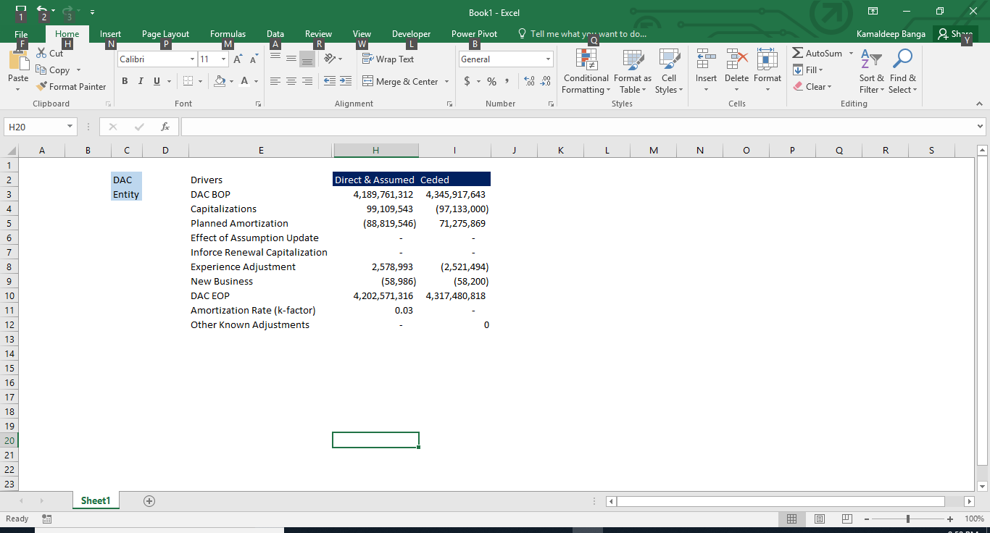
Modeling
Case Example 5 - Challenger Model Build to Validate US GAAP LDTI DAC Regulatory Changes
Purpose: To develop a simple tool to test the accuracy of the End User Computing Model’s for Deferred Acquisition Cost (DAC) amounts as per the regulatory changes under Long Duration Targeted Improvements (LDTI) for Annuities Direct and Reinsurance business.
Key Challenges:
1. Significant time and effort needed to understand regulatory changes for DAC disclosures under LDTI
2. Creating a model challenger framework that is useful for model stakeholders for faster identification of errors and improving reliability of EUC
3. Fine tuning of Challenger and EUC model as they would run parallel to each other
Step 1) Requirement Gathering & Design
Step 2) Model Input
Step 3) Model Build
Step 4) Model Output & Analysis
Step 5) Report Summary
Business Requirement Document
Inforce Cohort Level Data
Inforce premium Projections, Premium Deposits due to renewals or new business
Model Build
The model is built for DAC roll-forward calculations for Direct and reinsurance business
Roll-forward calculations
Generate roll-forward calculations and End of Period (EOP) DAC values for all cohorts
Report Summary
Preparation of a DAC summary report summarizing EOP DAC numbers and Drivers which Valuation team would use to compare outputs
Data Collection
Policy Admin systems, Actuarial software, Assumptions Guidance group
Financial Data
Initial DAC new capitalization on renewals and new business
Single Cohort Run
Running a Single cohort to validate the code
Result Analysis
Compare EOP DAC amounts of Challenger model with EUC model and report the discrepancies.
Sample report
Data Validation
Model Design
Design the build based on regulatory changes and stakeholder requirement
Identify & Fix the errors
Value Add:
1. Timely identification and correction of EUC model errors
2. Confidence that the figures to be published are accurate and in line with the regulations in place
3. Provides a simple check to the complex model calculations

Slide 13

Thank you
© 2024 ExlService Holdings, Inc. All rights reserved. For more information go to www.exlservice.com/legal-disclaimer

Slide 14
Lincon

Slide 15
Key Deliverables
Life Valuation - Workflow & Key Deliverables - VUL
End-to-end process for VUL valuation, including data preparation, model runs, reporting, and key deliverables across monthly, quarterly, annual cycles and adhoc processes
Process
Start
Input Data Cleaning & Scrubbing
Run the Triton Model
Run the access databases
a
Monthly
Quarterly
Remove Excess Termination
Map Plan IDs and cohorts using Triton Mapper
Scrub and Trim data
Link scrubbed DBFs and reinsurance files
Run macros and SSIS runs for ETL uploads
Fundroll
Inforce Policy List
Funds Released on Death
Reserve Trend Analysis
SOX Control – Input vs Triton Model Output
Sensitivity Analysis - PrePBR
Topside creation
SOX NS Control - Triton to Ledger Reconciliation
Commonwealth Allocations - reinsurance summaries, fundroll and deposit accounting
Generate Database files(DBFs)
Modify DBFs for access database uploads
Review for any Triton errors
VUL Fundroll
Analyze and complete reports
Others
a
Process improvements
Adhoc projects – Audit and Regulatory requirements
Adhoc
Annual
TXN modification
Out of Balance adjustments (Manual adjustments)
Fund roll SSIS upload to SQL
Support for NY147 related changes in Triton model
Support for EY Audit Requirements - Seriatim level cashflow projections
Power query implementation
Documentation Creation/Refinement
NY NY Binder
S&P Survey
Exhibit 3 - LNL/LNY
Exhibit 5 - LNL/LNY/FPP
State Pages - LNL/LNY/FPP
CFT Memos - LNL/LNY/FPP
Aetna Page 6
Aetna Policy counts, reserves, DB by state
End
Reserve Trend Analysis
Funds released on death
Update reinsurance and Commonwealth reports
Reasonable checks and adjustments

Slide 16
Key Deliverables
Life Valuation - Workflow & Key Deliverables - WLEC
End-to-end process for WLEC valuation, including data preparation, model runs, reporting, and key deliverables across monthly, quarterly, annual cycles and adhoc processes
Process
Monthly
Quarterly
Run the WLEC Master Macro to create file & Folder Structure
Check data issues in IFE files and correct them if possible
Run the Triton model
a
Tax Reserves
GAAP Files – DAC, VOBA (Value of Business Acquired)
Reserves Released on Termination
Reserve Reconciliation between ledger and triton output
Reserves report for ALM team
Seriatim level premium information for Auditor (EY)
SOX Controls
Footnote 1 - Net income & surplus for UL reserves calculated on Indiana method
Start
Death Claims Summary
Surrenders Summary
Legal Entity level Cash Value summary
Premiums past due summary by past due age in days
Statistics Report – Includes Fund Value, Face Amount etc
Reserve Report
Policy In-force Count
Create Folders
Rename files to reflect current Val date
Create batch file and run it to create Triton jobs
Update Interest rates
Scrub and merge the IFE files using MS Access database
Run Triton jobs and review the valuation errors
Others
Identify and implement process improvement opportunities
Identify and implement automation opportunities
Adhoc
Annual
a
Calculate Disability and Final Reserves
Analyze and Complete reports
NY Binder
S&P Survey
Fund Value report for AM Best
Exhibit of Life
Exhibit 5
Footnotes 31 – Deficiency Reserves Footnote 32 – Analysis of Annuity Reserves Footnote 33 - Analysis of Life Reserves
Year end filing - Page 7
Actuarial Opinion Pages
State Requests
NYSID Liquidity Survey
EY Audit Requirements - Seriatim level cashflows
Reinsurance (NETINFO) SQL Query Update
Data Check Model
Reserve Recalculation Model (Work in progress)
Documentation Creation/Refinement
Run Access queries to calculate Disability reserves (quarterly process)
Combine disability reserves with reserves from Triton jobs to reach to final reserves.
Update death claims, surrender claims, 2 to 1 policies, due premiums and cash value information in the respective files and analyze the trend for change in reserve, fund value and face amount
Check for reasonableness and send for review
End

Slide 17
Life Modeling
Account Value Roll Forward (AVRF) Project – MG-ALFA
Objective
Account Value Roll Forward Excel Replication
Replicated and automated Account Value roll forward (AVRF) calculation in excel to enable reporting post integrate update.
Account Value Roll Forward Reconciliation
Working on identifying and reconciling gaps in AVRF to resolve any breaks and leakages.
Key validations ensured General and Separate Account values reconciled with Total Account Value, and balancing items remained minimal.
Simplistic Example explained below
PV Values in Millions | Values |  |  | Differences
 | Step 1 | Step 2 | Step 3 | Step 2 | Step 3
Separate Account
BOP Value | 12 | 12 | 12 | - | -
+ Premiums Collected | 1 | 1 | 1 | - | -
- Mortality Charges | - | - | - | - | -
- Expenses | - | - | - | - | -
Unexplained Variance | - | - | - | - | -
EOP Value | 13 | 13 | 13 | - | -
General Account
BOP Value | 51 | 51 | 51 | - | -
+ Premiums Collected | - | 1 | 1 | 1 | -
- Mortality Charges | - | - | -2 | - | -2
- Expenses | - | - | -1 | - | -1
Unexplained Variance | -4 | -5 | -2 | -1 | 3
EOP Value | 47 | 47 | 47 | - | -
Total Account
BOP Value | 63 | 63 | 63 | - | -
+ Premiums Collected | 2 | 2 | 2 | - | -
- Mortality Charges | -2 | -2 | -2 | - | -
- Expenses | -1 | -1 | -1 | - | -
Unexplained Variance | -2 | -2 | -2 | - | -
EOP Value | 60 | 60 | 60 | - | -
Step 1 – Baseline
Roll forward generated separately for Separate, General, and Total Accounts
Initial unexplained variance identified
Step 2 – Attribution
Separate Account validated as stable
Variance traced to General Account by line item
Step 3 – Alignment
Model logic updated in General Account
Variance shifts from unexplained to explained line items
Final Check
Unexplained variance in Total Account = General Account variance + Separate Account variance

Slide 18





Group Rater Modeling - Short Term Disability / Long Term Disability
Group STD/LTD Rater model
Modeling
Case Example: Group Rater Modeling Process
Modelling Team developed an integrated and user-friendly system to enable Sales team to provide instant quotations and increase client conversion rates.
Background
Application Process Flow
Technology
Old system was based on VBA and had higher dependency on production team. Model Run time to provide premium quotes was in weeks and it does not provide intermediate calculations for STAT OFFSET plans.
Key Objectives:
Develop easy to use/modifiable application.
Reduce the run time significantly.
Develop proper documentation for future use/updates.
Provide standardized reports and dashboards for real-time insights.
Dataiku (using SQL queries) is used to fetch and integrate data from other database systems.
Discrete and Organized SQL queries for stepwise STAT OFFSET calculation being visible and editable.
Database system 1
Dataiku
Dataiku
(STAT OFFSET calculation)
SQL queries are used to perform the final premium quotes calculations.
Start
Database system 2
Value Proposition
Challenges
~90-95% reduction in runtime with higher accuracy
Develop easy to use API
Easy integration with tools like Power BI
Scalable framework
Optimized & leaner code
Feasible model/assumption updates
Lack of model documentation.
Dependency on Production team for model updates.
Manually run single quote through MS-access.
Rating Batch takes multiple weeks of time to run.
Existing system had few bugs.
Team does not had access to the intermediate calculations / outputs of STAT OFFSET plans.
Lack of Standardized results format.
Manual intervention is required by an underwriter, which is prone to human error, and leads to governance/auditing issues as well.
Dataiku
(Premium Quotes)
Database System 3
Dataiku can interface with reporting tools (like Power BI) to extract the standardized reports and allows for real-time insights
Final Reports
/ Dashboards
Notes:
Interesting case study on Process Improvement using Python
Longevity Risk Model in excel. Output of this model is effect of longevity on Liability CF
Advantage of Excel – Better auditability, better transparency, better understanding of flow of calculation
Disadvantage – NO centralised LRM model, High run time, Susceptible to error, not scalable.
We used Python and Casandra database to create web-based environment to create Excel like environment.

Slide 19

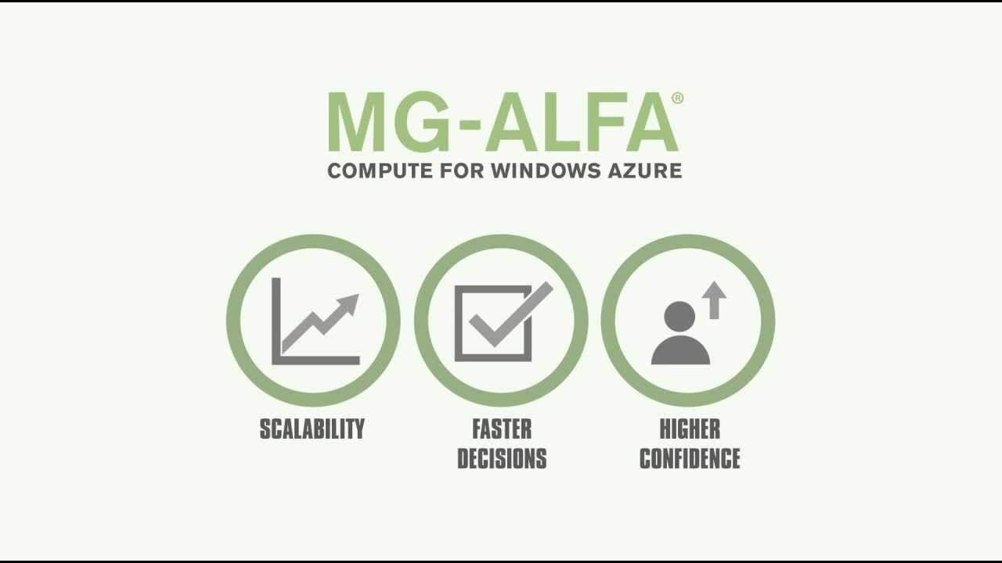
Annuity Pricing Rate Monitor and Adjustments
Case Example
Annuity Pricing Monitoring work – version 1
Purpose is to calculate profitability and other product metrics that are used both in making pricing decisions and financial planning & analysis.
Background
Pricing Validation Process Flow
Technology
Weekly option rates, SOFR rates,
Liability discount rate curve, asset yield spreads, policy sales data
In the existing process workflow, FIA, ForeCare, RILA and ForeCertain annuity products are covered. Pricing team needs updated results on weekly basis after incorporating latest option rates, asset spread yields, policy sales data etc.
Key Objectives:
Provide extensive support to pricing team in monitoring annuity pricing experience and update rates (if required).
Calculate profitability and various other product metrics for pricing team to help in decision making and financial planning & analysis.
Adhere timelines and maintain filing structure for audit purposes.
Model Reconciliation with Previous Week Results
Create new week folder structure and Save new files
Results Comparison
Based on latest results, stakeholders decide to keep same pricing rates or propose new rates (to be implemented from next week onwards) and may ask to provide some sensitivity results as well
Estimate cost of crediting/crediting rates based on new rates
Value Proposition
Created detail documentation and checklist to standardized process and remove in between gaps
Developed few macros to remove manual intervention and hence reducing the possibility of errors
Production Model Run (MG-ALFA)
Communicate final results to stakeholders
Start
Archive Results into master template for future reference
Challenges
Process Gaps
Partial Process automations
Investment out-performance adjustment
Prepare build files for MG-ALFA Run
Short Timelines
Build files contains for various pricing inputs like commission rates, crediting rates, scenarios etc.
Input dependencies on different teams

Slide 20
Annuity Pricing Rate Monitor and Adjustments
Case Example
Annuity Pricing Monitoring work – version 1
Purpose is to calculate profitability and other product metrics that are used both in making pricing decisions and financial planning & analysis.
Background
Pricing Validation Process Flow
Technology
Weekly option rates, SOFR rates,
Liability discount rate curve, asset yield spreads, policy sales data
In the existing process workflow, FIA, ForeCare, RILA and ForeCertain annuity products are covered. Pricing team needs updated results on weekly basis after incorporating latest option rates, asset spread yields, policy sales data etc.
Key Objectives:
Provide extensive support to pricing team in monitoring annuity pricing experience and update rates (if required).
Calculate profitability and various other product metrics for pricing team to help in decision making and financial planning & analysis.
Adhere timelines and maintain filing structure for audit purposes.
Model Reconciliation with Previous Week Results
Create new week folder structure and Save new files
Results Comparison
Based on latest results, stakeholders decide to keep same pricing rates or propose new rates (to be implemented from next week onwards) and may ask to provide some sensitivity results as well
Estimate cost of crediting/crediting rates based on new rates
Value Proposition
Created detail documentation and checklist to standardized process and remove in between gaps
Developed few macros to remove manual intervention and hence reducing the possibility of errors
Production Model Run (MG-ALFA)
Communicate final results to stakeholders
Start
Archive Results into master template for future reference
Challenges
Process Gaps
Partial Process automations
Investment out-performance adjustment
Prepare build files for MG-ALFA Run
Short Timelines
Build files contains for various pricing inputs like commission rates, crediting rates, scenarios etc.
Input dependencies on different teams

Slide 21
Annuity Pricing Rate Monitor and Adjustments
Case Example
Annuity Pricing Monitoring work – version 2
Purpose is to calculate profitability and other product metrics that are used both in making pricing decisions and financial planning & analysis.
MG-ALFA Run
and Results
Comparison
New week Folder Structure & Input
files
Estimate Cost of Crediting
Investment out-performance adjustment
Prepare
Build Files for
Model Run
Communicate Results
Archive
Results
Crediting
Rates Update
Benefits
Model Run
Execute MG-ALFA production model from last week.
Perform results reconciliation from prior week summary files to make sure there are no uninformed changes with in the production model.
New Folder Structure
Create new week folder structure and save the following input files in it.
Weekly option rates
SOFR rates
Liability discount rate curve
Asset yield spreads
Policy sales data etc.
Cost of Crediting Estimate cost of crediting/crediting rates for various annuity products based on latest asset spread yields, weekly options etc.
Out-performance adjustment
Adjust the cost of crediting/crediting rates estimated in previous step to incorporate investment out-performances.
Build Files
Build files are input files for MG-ALFA model.
Build files contain various pricing inputs like commission rates, crediting rates, scenarios etc.
Results Summary
Prepare summary files for all annuity products and share it with stakeholders.
Stakeholders may ask to provide sensitivity results as well.
Archive Results
Archive the latest Results into master template for future reference.
Crediting Rates Update
Based on latest results, stakeholders decide to keep the same pricing rates or propose new rates (to be implemented from next week onwards).
Value Proposition
Created detail documentation and checklist to standardized process and remove in between gaps
Developed few macros to remove manual intervention and hence reducing the possibility of errors
Actuary
Technology

Slide 22
EXL GGY Axis Implementation Capabilities
Model Development &
Integration
Model Enhancement
Model Review &
Governance
Regulatory Reporting &
Cash Flow Testing
Model Optimization
End-to-end modelling and integration support for VA, RILA, Payout, FA, and FIA annuity products.
Built and onboarded models (into GGY AXIS) for reserves, cash flows, and account value projections.
Ensure consistency and scalability across valuation processes.
Multi-framework build and support (VM21, GAAP, DAC and local regulations)
Enhanced models to incorporate new products/variants and updated ALM strategies.
Improved reserves calculation accuracy and assumption loading processes.
Scenario Testing and dynamic lapse modeling
Assumption updates, testing, and validation
Update legacy variables with new code logic; assumption changes & product feature evolution
Performed UAT cycles in collaboration with business stakeholders to validate model change requests.
Developed structured templates and processes for assumptions review.
Improved version control, regulatory-compliant documentation and audit readiness.
validate single policy results.
Built economic and behavioral stress testing scenarios.
Provided insights into reserve sensitivity and capital adequacy planning.
Supported annual assumption unlocking and ad-hoc ALM stress testing requests.
Monthly/quarterly/annual valuation reporting for Life and Annuity products
SQL-based policy transformation models for streamlined data management.
E-Link job automation and workflow optimization.
Support for quarterly unlocking and assumption review cycles.
Automated reporting, data transformation, and reconciliation.
SQL and Python scripting and Excel-based validation tools.
EXL underlying Strengths in GGY AXIS Modelling & Governance
GGY AXIS Modeling
Areas
Data, Assumptions and Reserve Basis
Model development & Maintenance
Regulatory / Compliance readiness
Peer review
Audit-ready Visualization & documentation
+
+
+
+
Notes:
SG – Collective capabilities

Slide 23
Policy Illustrations and Annual Statements
GA Illustration work
Case Example
Background
Type of Requests Delivered
Insurance policy illustration work involves creating visual representations of insurance policies to help policyholders understand the benefits, costs, and key features for Universal Life, Whole Life products.. These typically includes:
Premium Breakdown: Detailed explanation of various payment options.
Death Benefits: Overview of payouts to beneficiaries.
Cash Value Accumulation: Insights into any savings components and growth potential.
Illustration Assumptions: Clarification of underlying assumptions, such as interest and mortality rates.
Standard Illustrations
Solve to Maturity Premium
Level Maximum Premium
True Maximum Premium
Guideline Based Premium
Annual Statements
Key Objective
Death Claim
Change in Death Benefit
Key objectives are to provide clarity, facilitate comparison among policies, and enhance transparency.
Adherence to regulatory requirements by offering detailed annual reporting and ensuring that illustrations accurately reflect policy terms.
Best practices include tailoring illustrations to individual policyholder needs and regularly updating them to reflect any changes in the policy or the client's circumstances.
Overall, effective policy illustrations empower clients to make informed decisions about their insurance options.
Change in Policy Face Amount
Policy Standard Values
Loan Repayment
Rider coverages
Benefits Delivered
Delivered various policy type requests like Universal Life, Whole Life etc.
Maximum work delivered from offshore location.
Dedicated resource team with relevant illustration work experience.
Key Challenges
Multiple Policy Administration Systems makes it Complicated to manage diverse policies.
Inefficiencies due to outdated legacy tools.
Maintaining accurate illustrations with frequent policy changes.
Macro-based Excel tools were difficult to understand.
Lack of actuarial knowledge on the transitioning team’s end.
Tight Deadlines to complete illustrations.
Variety of riders complicates the standardization of illustration work.
Confusion arose from managing multiple template versions.
Enforcing access controls for sensitive policy data offshore.
2025
100%
100%
2024
100%
95%
SLA’s
Quality
Timeliness

Slide 24
Lincoln Financial Group – Data Modernization
Data modernization using Dataiku
Objective: To document the scattered data transformation across SAS, Excel, Access, AXIS, Dataiku etc., and provide a clear data flow to enable backtracking and support future logic modifications.
Data
Flow
IT Inforce Data
Post –IT Transformation
(SAS)
Transformation
(Dataiku)
Post transformation – Sent to SQL Database
AXIS Inforce (PIT, DIT, DHT)
AXIS Runs Output
Data Warehousing (Dataiku)
Output Transformation (Dataiku)
ARVM DW
Tableau/Excel
Reports
Achievements:
Delivered comprehensive data dictionaries for 5 annuity models with ~95% completion.
Created Input, Output, and DW data dictionaries for each Annuity model.
Supported on 150+ review‑phase questions
Found and Documented inter-dependencies of Data within GGY AXIS
Benefits:
Created a single, end to end documentation of flow of data
Improved cross team understanding of Annuity data flow
Enabled easy tracing of any field from raw data till final Output
Made future data updates and transformations easier
Identified coding gaps and inefficiencies in transformations
Combined and documented logic from all tools, hence multi-tool navigation/expertise not required
Hyperlink exists for various stages of transformation

Slide 25
Experience Analysis: Term, Whole Life, Universal and Variable Universal Life Products
From Raw Data to Assumptions: Driving Data- Driven Assumption Setting through scalable Experience Analytics
Application Process Flow
 | Background:
Technology
Fragmented data and manual processes limit credible lapse, surrender, and mortality assumption setting driving the need for a standardized, automated, and audit- ready experience study framework.
Key Objectives:
Establish a standardized and automated framework across Products.
Ensure accurate exposure and decrement calculations to support A/E analysis.
Enable robust assumption and governance aligned with valuation and regulatory requirements
Improve efficiency and scalability by reducing manual intervention and turnaround time.
Deliver actionable insights through granular segmentation (product, duration, cohort) to support business decision making.
Data Processing Framework
Data source from multiple systems
Uploaded into SQL SERVER database
Processed using Stored Procedures and SQl logic
Dataiku
SAS
Data Transformation and Storage
Creation of structured tables:
- Policy and Coverage data
- Product attributes
- Terminations and lapses
-Exposure calculations
Value Proposition
Faster turnaround time
Enhanced client insights
Easy integration with tools Tableau
Scalable framework
Improved accuracy and governance
Experience Study Calculations
lapse rate calculations (actual experience)
Mortality studies using exposure methodology
Periodic Database updates
Final Reports​
/ Dashboards
Notes:
Interesting case study on Process Improvement using Python
Longevity Risk Model in excel. Output of this model is effect of longevity on Liability CF
Advantage of Excel – Better auditability, better transparency, better understanding of flow of calculation
Disadvantage – NO centralised LRM model, High run time, Susceptible to error, not scalable.
We used Python and Casandra database to create web-based environment to create Excel like environment.

Slide 26





SPARTA - Overview
SPARTA – A product built upon actuarial domain expertise and equipped with artificial intelligence
Problem Statement
Approach
Legacy infrastructure has impeded companies’ ability to address broad customer, digital, cost, consolidation and regulatory trends. To the extent it has been contemplated, migrating from these outdated systems has proved challenging and expensive.
Lack of Transparency for Audit purposes (Governance issues)
Data security issues due to involvement of third-party vendors.
Data Processing
Gen AI Enabled Modeling
Output
Extract –Transform - Load
Integrating and Processing data using prompts for LLM.
Standardized output for analysis
Data
Product
Configuration
Assumptions
Calculation
Validation
Benefit/Impact/Output
EXL has developed SPARTA , a platform that takes a product-centric approach to unpackaging legacy data, to enable the recreation and validation of product and processing logic. SPARTA leverages a modular, scalable design allowing for rapid implementation and validation across a wide range of client products
Flow
Legacy System
Conversion Flow
Reconciliation
SPARTA
LifePro
Notes:
OEM – Original Equipment Manufacturers, LLM – Large Language Models, FNOL – First Notice Of Loss, CAN – Controller Area Network, GPS – Global Positioning System, EDR – Event Data Recorders, EV SOC – Electrical Vehicle State of Charge

Slide 27

SPARTA Solution Architecture Overview
Leveraged advanced AI algorithms to analyze large-scale policyholder data across the legacy system and Life Pro.
Ensure accurate data mapping between systems for consistency and reliability.
Detect discrepancies in data to prevent errors and improve quality.
Identify patterns and trends for enhanced data integrity and operational insights.
Enable faster reconciliation of mismatched records to streamline processes.
Facilitate root cause analysis for data issues, reducing investigation time.
Reduce manual effort through automation and intelligent checks.
Enhance audit transparency by providing clear, traceable data validation processes.
Data Processing
Calculation Engine
Outputs
Output Comparison
Preprocessing
Product Configuration
LLM
Data Source
PCONVERT data
RDBMS backup data
Manual upload
(xml, xlsx, csv, txt, etc)
Assumptions
Calculation
Engine
Output
Advanced AI Algorithms
Mapping
LLM
Tech Stack
Python Scripts
JavaScript
HTML
Data Collation & Source identification:
Extract/Receive data from legacy system.
Identifying file format, unzipping & uploading data to Amazon S3 bucket
Data Ingestion & Transformation (Using LLM):
XML Analysis (Sample Data) - Mapping Analysis- performing initial schema detection/metadata read
Loading raw data into staging area and performing sanity checks on it (After approval/clarification from client)
Data Parsing – format specific
Data cleansing
Segregating the data into policy information and transaction information, based on functional inputs
Data Upload:
Store procedure have been implemented to get LifePro table replica
Stored procedure for merging/stacking the required LifePro replica tables made in above step) that will be used by calculation engine.
Assumptions:
Assumptions from the uploaded parent data appear under this tab
Displays details: name, product code, product name, ranges, status, and last update.
If assumptions weren’t captured earlier, use ‘Choose File’ to upload or update them.
Product Configuration:
Quickly view product details like name, rider type, description, type, code.
Options include uploading input data, editing riders, ,Modifying the parent Python script for the desired product
The Sparta platform produces standardized output that can –
Prepare Standard Data
Validate system Setup
Identify & analyze Legacy/New-PAS errors
Provide AI based validation Reports
Notes:
New format needed.

Slide 28
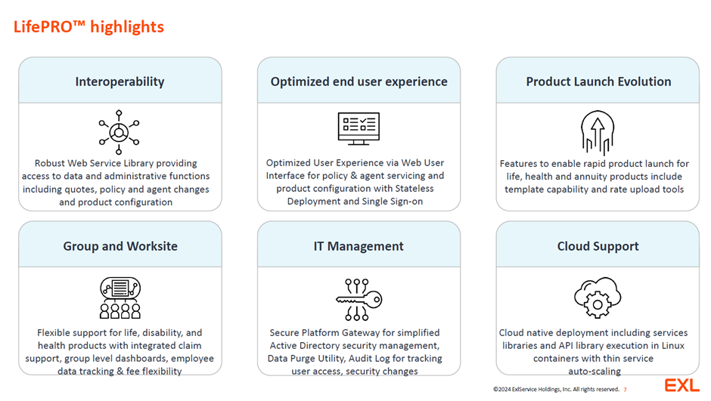

Slide 29
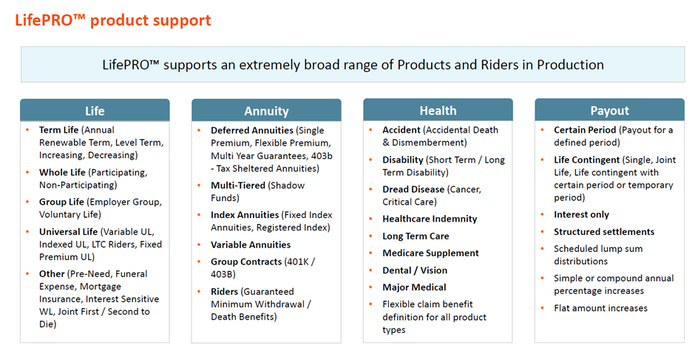

Slide 30
Python Modelling for FIA
CLIENT CHALLENGES
Manual and time‑intensive FIA validation in Excel
OUR SOLUTION
Modular Python‑based FIA modeling framework
CLIENT VALUE
Faster execution and reduced turnaround time
Limited transparency and audit traceability
Performance issues at higher policy volumes
Complex change management for assumptions
Centralized assumptions and formula logic
Automated, repeatable, and auditable execution
Aligned to existing actuarial workflows
SCOPE OF WORK
Replicate FIA validation logic with output reconciliation
Modular separation of data, assumptions, calculations, outputs
Axis integration as single source of inputs
Multi‑policy processing and reporting layer
Built‑in audit traceability and structured debugging
Lower operational risk and manual dependency
Audit‑ready, regulator‑friendly outputs
Flexible foundation for future product expansion
Notes:
New format needed.

